Slide 2
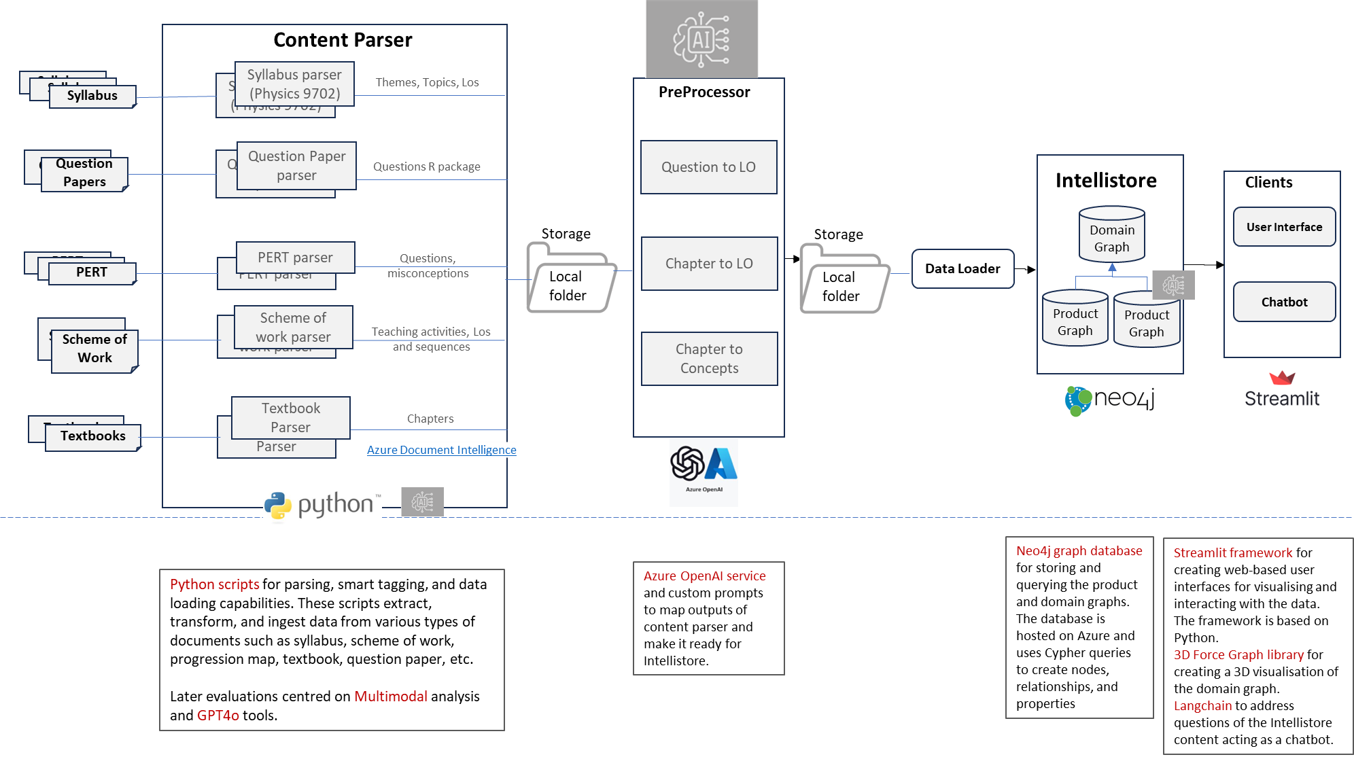
Capabilities flow graph

Slide 3
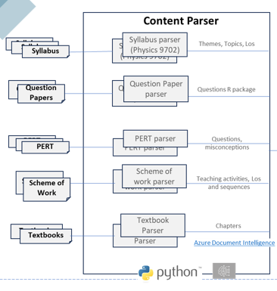
Content Parser
Content Parser Documents
Syllabus
Question Papers
PERT
Scheme of Work
Textbooks

Slide 4


Content Parser Documents
Syllabus
Question Papers
PERT
Scheme of Work
Textbooks

Slide 5
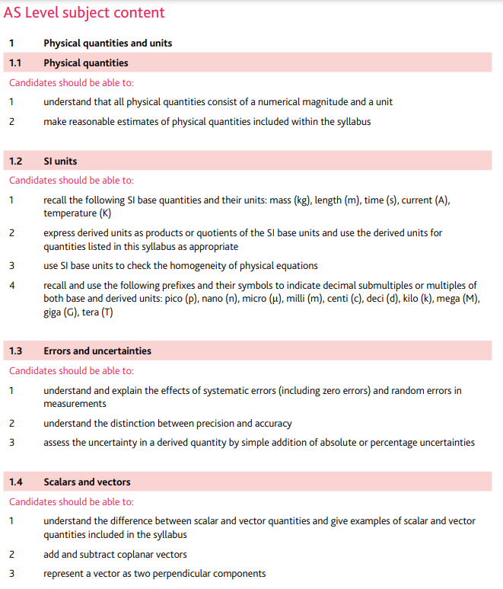

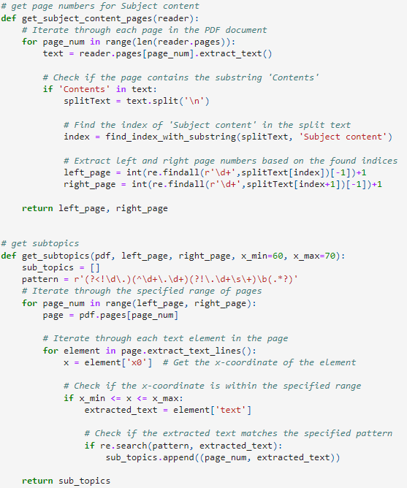
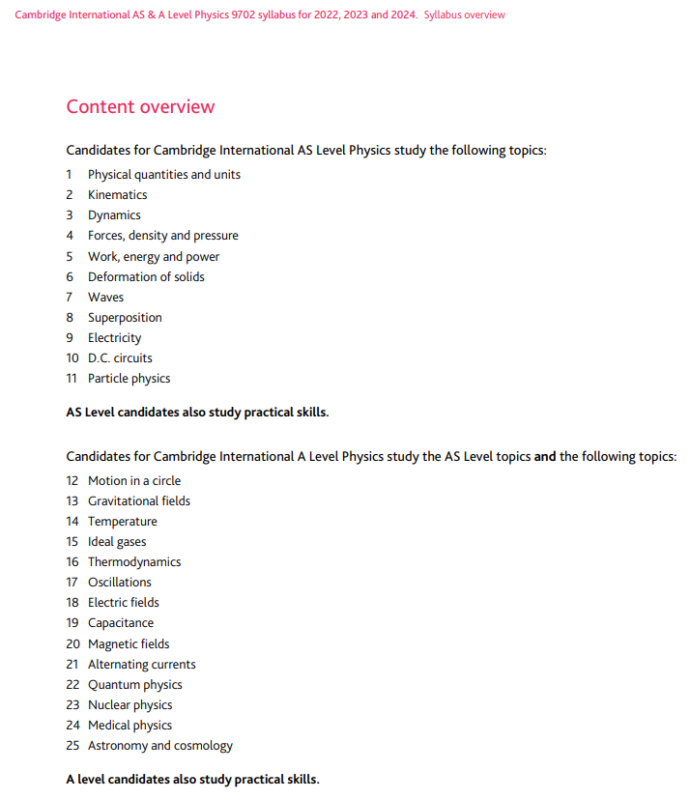
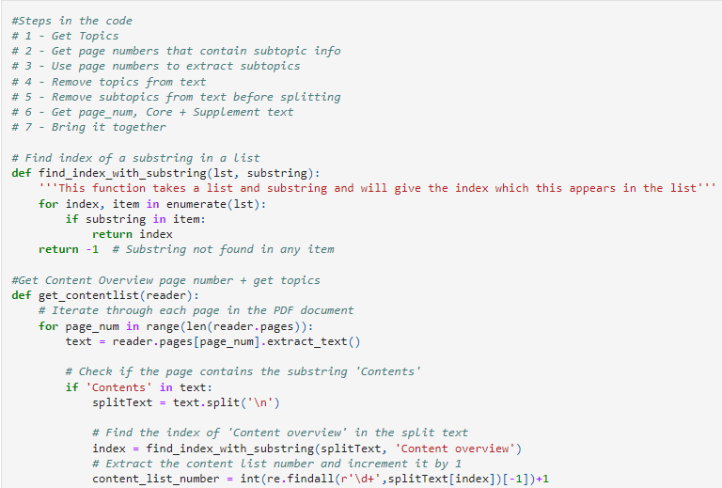
Targeted content extraction with:
Python PDF reader library
Python PDF plumber library

Slide 6
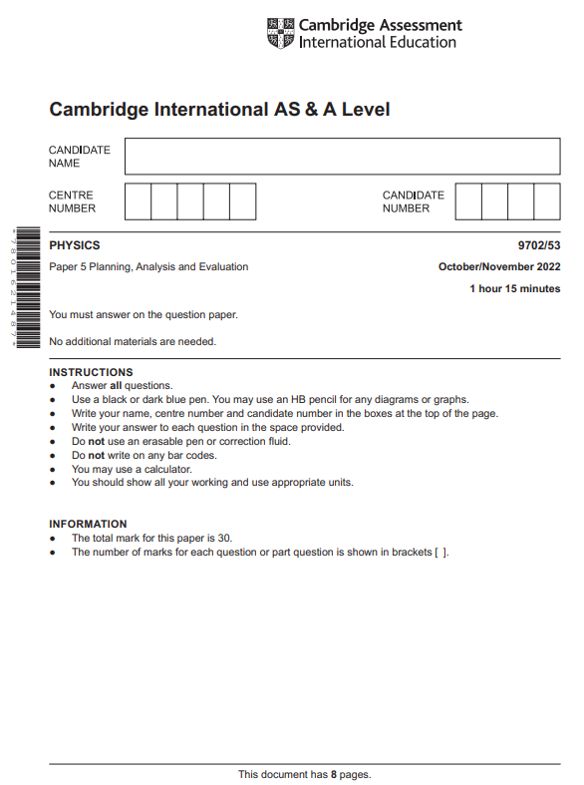

Content Parser Documents
Syllabus
Question Papers
PERT
Scheme of Work
Textbooks

Slide 7
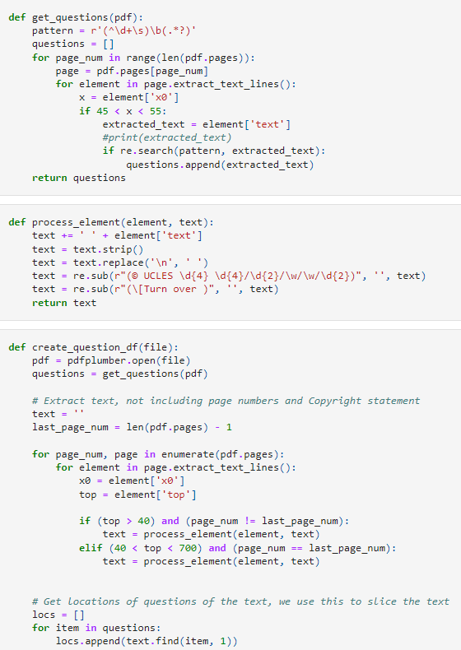
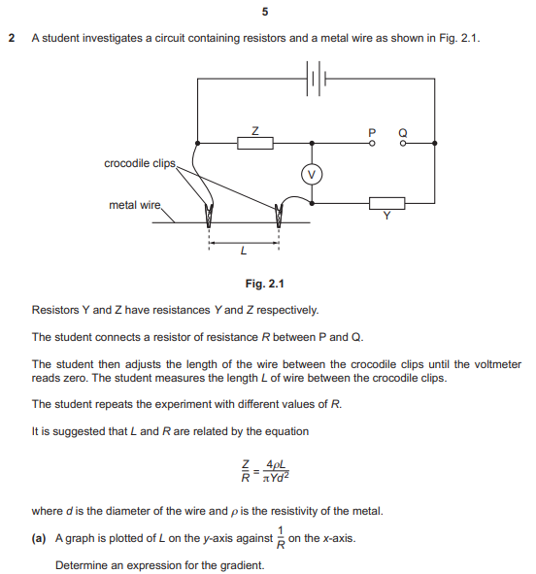
1) Targeted content extraction with:
Python PDF reader library
Python PDF plumber library

Slide 8
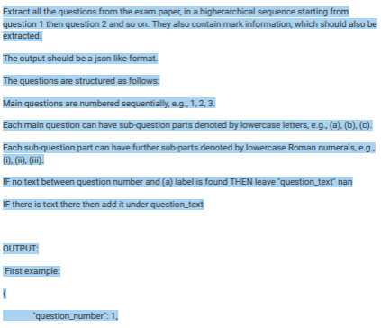

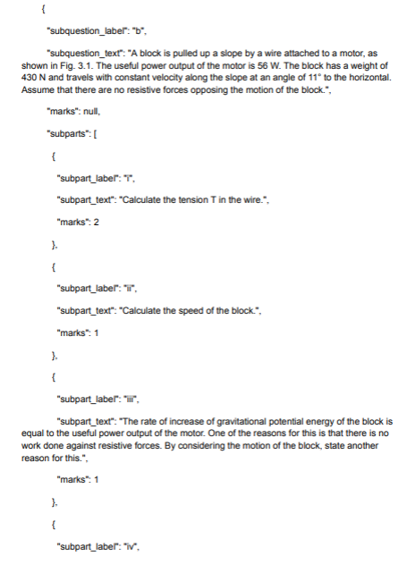

2) Targeted content extraction with:
Very detailed LLM Prompt with examples

Slide 9
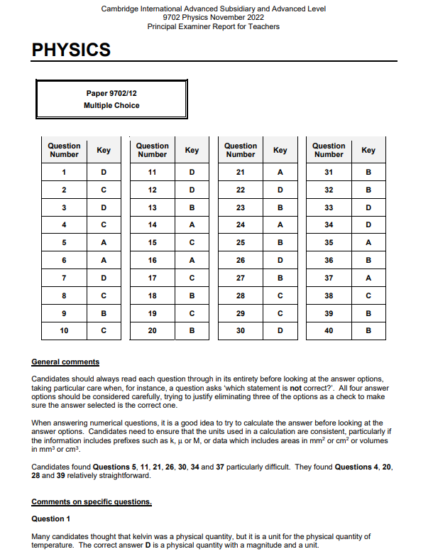
Content Parser Documents
Syllabus
Question Papers
PERT
Scheme of Work
Textbooks

Slide 10
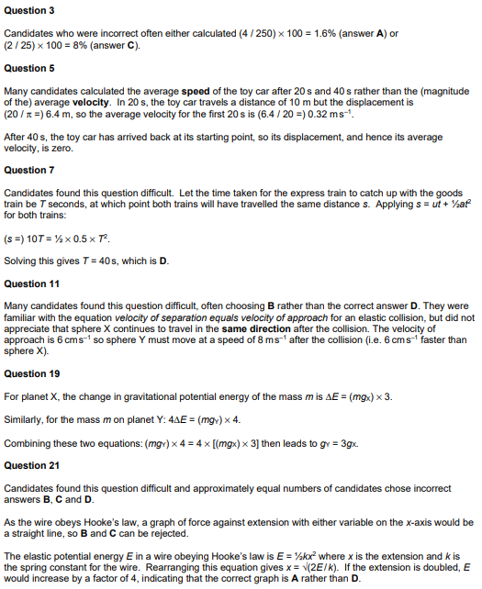
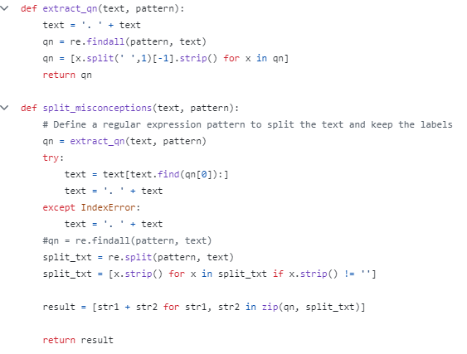

Slide 11


Content Parser Documents
Syllabus
Question Papers
PERT
Scheme of Work
Textbooks

Slide 12
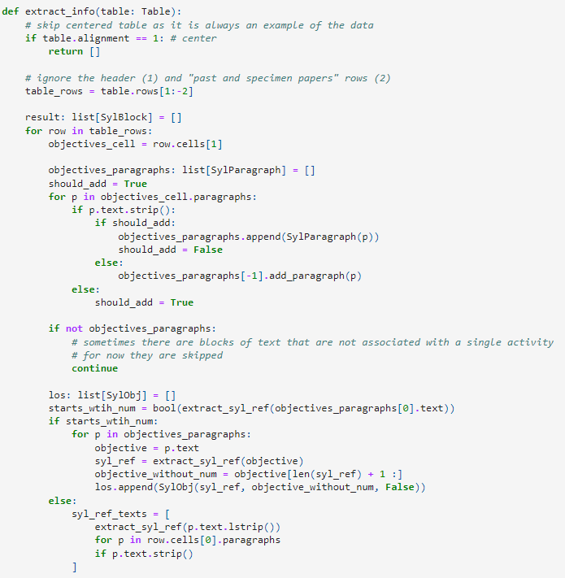

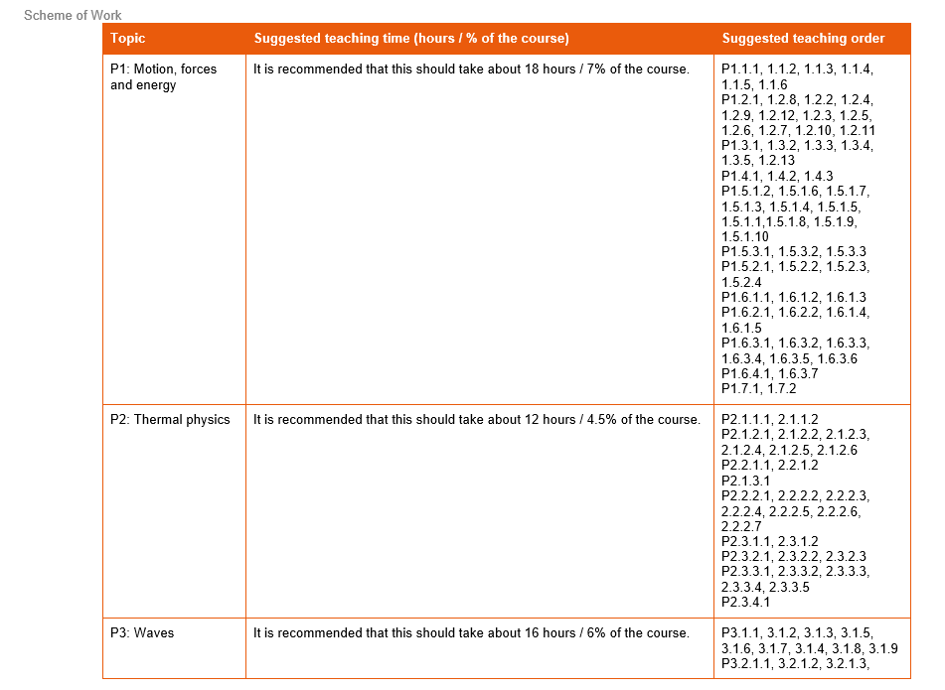
Targeted content extraction with:
Python .docx library

Slide 13

Content Parser Documents
Syllabus
Question Papers
PERT
Scheme of Work
Textbooks

Slide 14

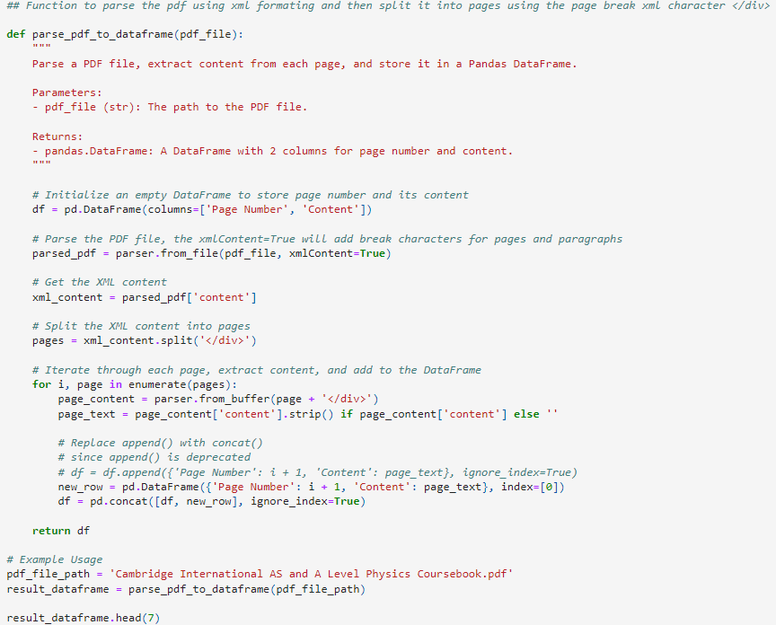
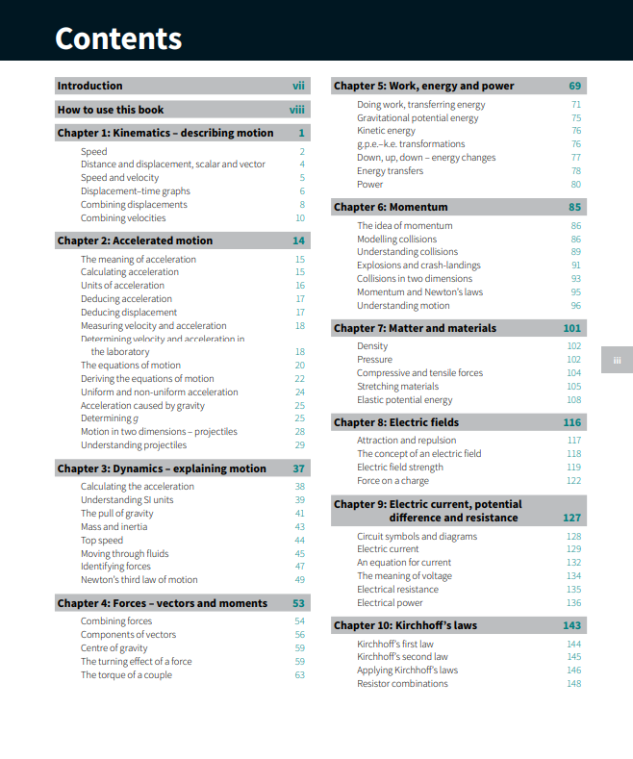
Targeted content extraction with:
Apache Tika Python library

Slide 15
INTELLISTORE

Slide 16
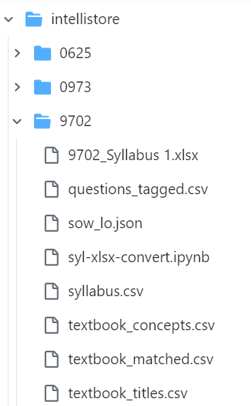


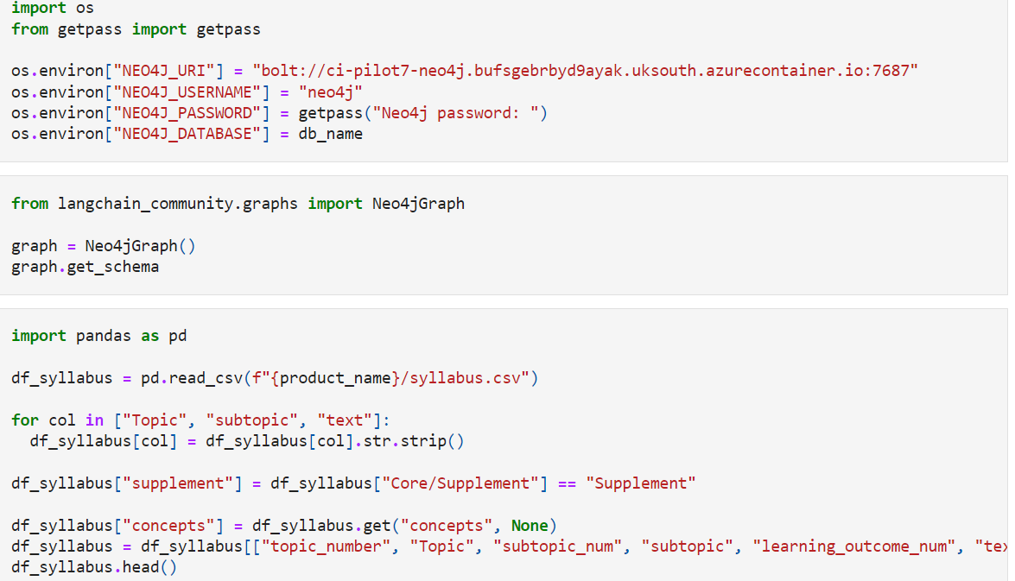
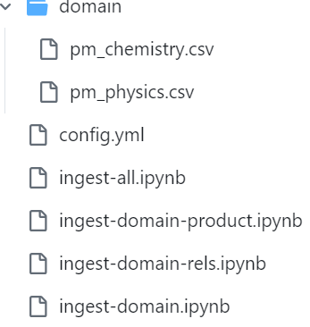

Slide 17
SMARTAG

Slide 18
SMARTTAG

Slide 19


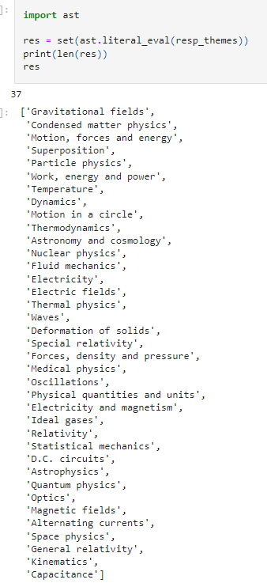
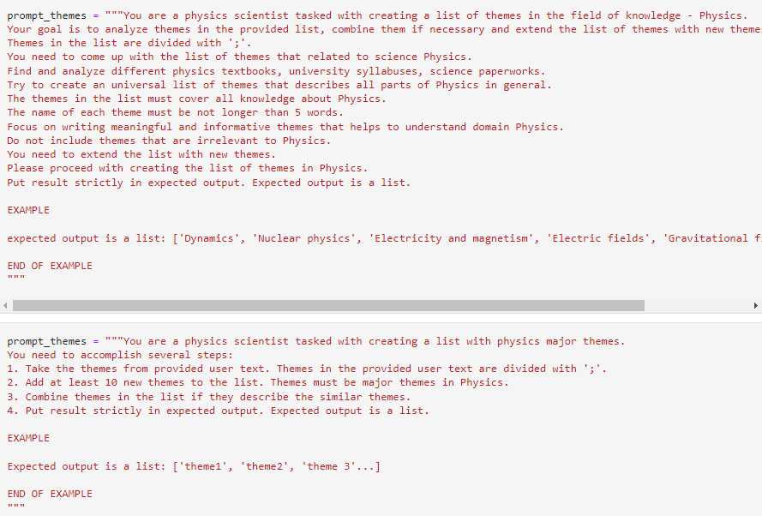
1) Get Domain Nodes (Syllabus & Scheme of work)

Slide 20
SMARTTAG

Slide 21
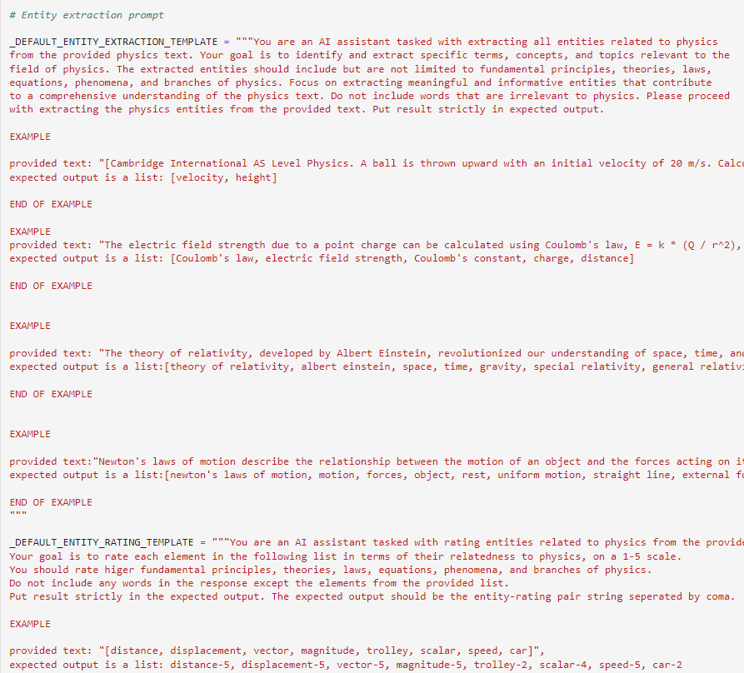
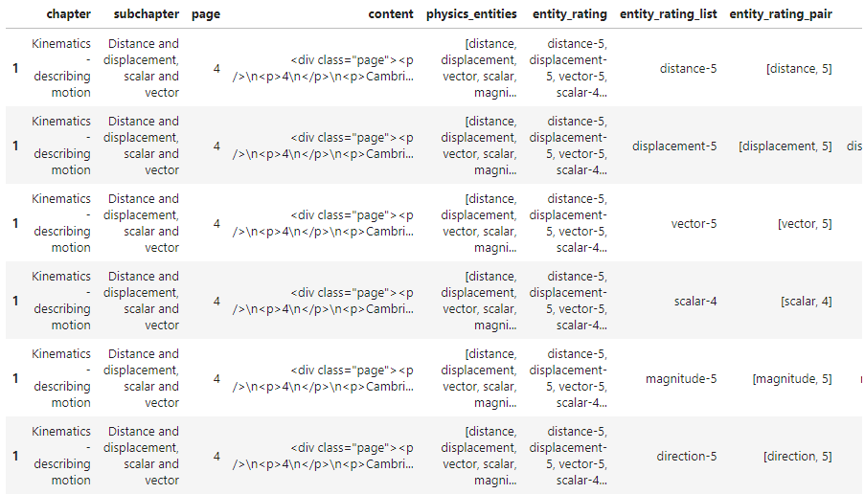
2) Chapter to concepts

